Slide 1
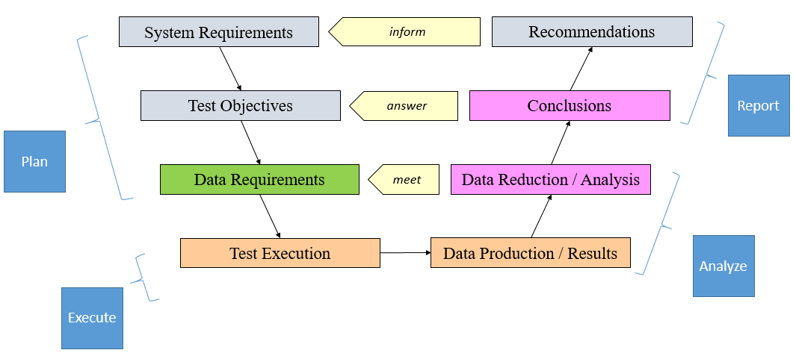
Systems Engineering Mindset
Problem Decomposition

Slide 2
Day Three Project
Given a scenario
Students will be able to:
Apply a systems engineering mindset to clearly identify program objectives and translate them into data requirements collected via the appropriate flight test techniques.
Identify and mitigate safety, security, technical, and program risks using a build-up approach where appropriate.
Effectively identify the proper resources required successfully meet the stated objectives.
Requirements → Objectives → MOPs →FTT →Data/Resources
Risk → Mitigation/Management

